Slide 1
Chap. 5: Logistic Regression

Slide 2
Reference
Ch.5: Logistic Regression, Dan Jurafsky and James H. Martin. Speech and Language Processing (3rd ed. draft)

Slide 3
Outline
Background: generative and discriminative classifiers
Classification in logistic regression
Logistic Regression: a text example on sentiment classification
Learning: Cross-Entropy Loss
Stochastic Gradient Descent
Stochastic Gradient Descent: An example and more details
Regularization
Multinomial Logistic Regression

Slide 4
Logistic Regression
Background: Generative and Discriminative Classifiers
Notes:
In this lecture we talk about the difference between generative and discriminative classifiers, and the relationship between Naïve Bayes and Logistic Regression.

Slide 5
Logistic Regression
Important analytic tool in natural and social sciences
Baseline supervised machine learning tool for classification
Is also the foundation of neural networks

Slide 6
Generative and Discriminative Classifiers
Naive Bayes is a generative classifier
By contrast:
Logistic regression is a discriminative classifier

Slide 7


Generative and Discriminative Classifiers
Suppose we're distinguishing cat from dog images
imagenet
imagenet

Slide 8
Generative Classifier:
Build a model of what's in a cat image
Knows about whiskers, ears, eyes
Assigns a probability to any image:
how cat-y is this image?
Also build a model for dog images
Now given a new image:
Run both models and see which one fits better

Slide 9
Discriminative Classifier
Just try to distinguish dogs from cats
Oh look, dogs have collars!
Let's ignore everything else

Slide 10
Finding the correct class c from a document d in Generative vs Discriminative Classifiers
Naive Bayes
Logistic Regression
posterior
P(c|d)

Slide 11
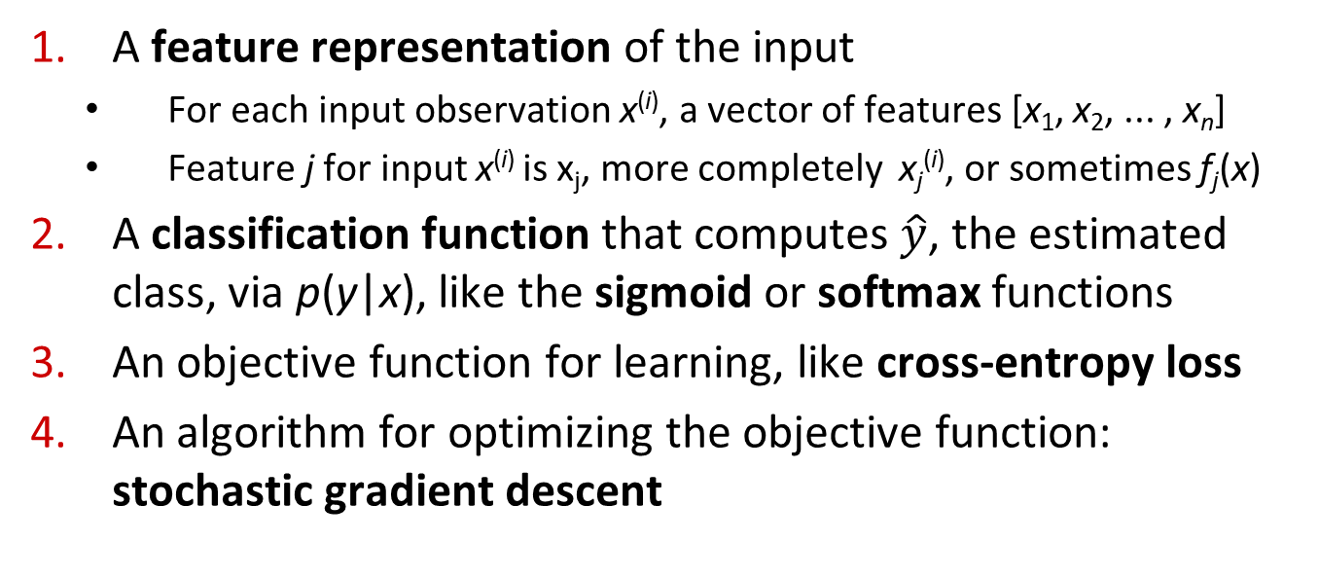
Components of a probabilistic machine learning classifier
Given m input/output pairs (x^{(i),}y^{(i)}):
A feature representation of the input
For each input observation x^{(i)}, a vector of features [x₁, x₂, ... , x_{n}]
Feature j for input x^{(i)} is x_{j}, more completely x_{j}^{(i)}, or sometimes f_{j}(x)
A classification function that computes $\hat{y}$, the estimated class, via p(y|x), like the sigmoid or softmax functions
An objective function for learning, like cross-entropy loss
An algorithm for optimizing the objective function: stochastic gradient descent

Slide 12
The two phases of logistic regression
Training: we learn weights w and b using stochastic gradient descent and cross-entropy loss
Test: Given a test example x we compute p(y|x) using learned weights w and b, and return whichever label (y = 1 or y = 0) is higher probability

Slide 13
Logistic Regression
Classification in Logistic Regression
Notes:
In this lecture we'll see how to do classification with logistic regression and introduce the important sigmoid function

Slide 14

Classification Reminder
Positive/negative sentiment
Spam/not spam
Authorship attribution (Hamilton or Madison?)
Alexander Hamilton

Slide 15
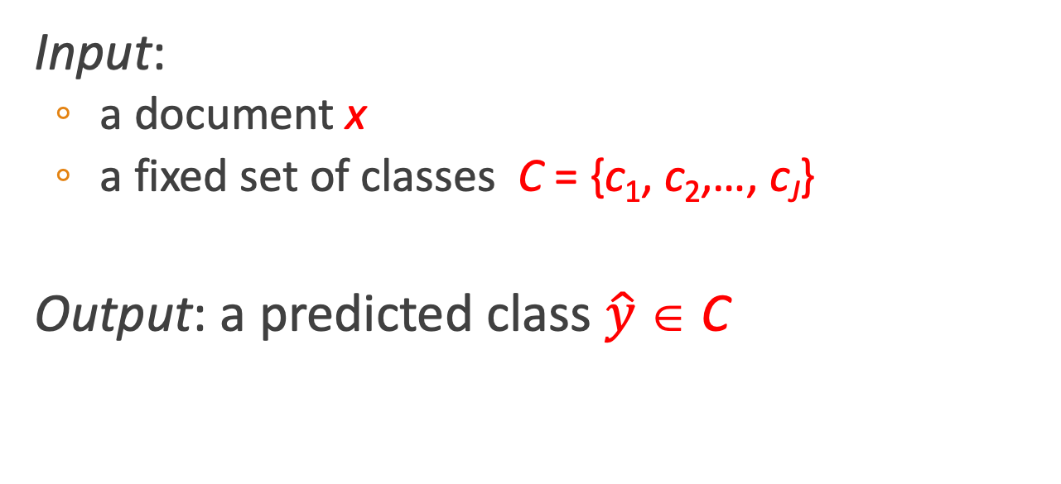
Text Classification: definition
Input:
a document x
a fixed set of classes C = {c₁, c₂,…, c_{J}}
Output: a predicted class $\hat{y}$ ∈ C

Slide 16
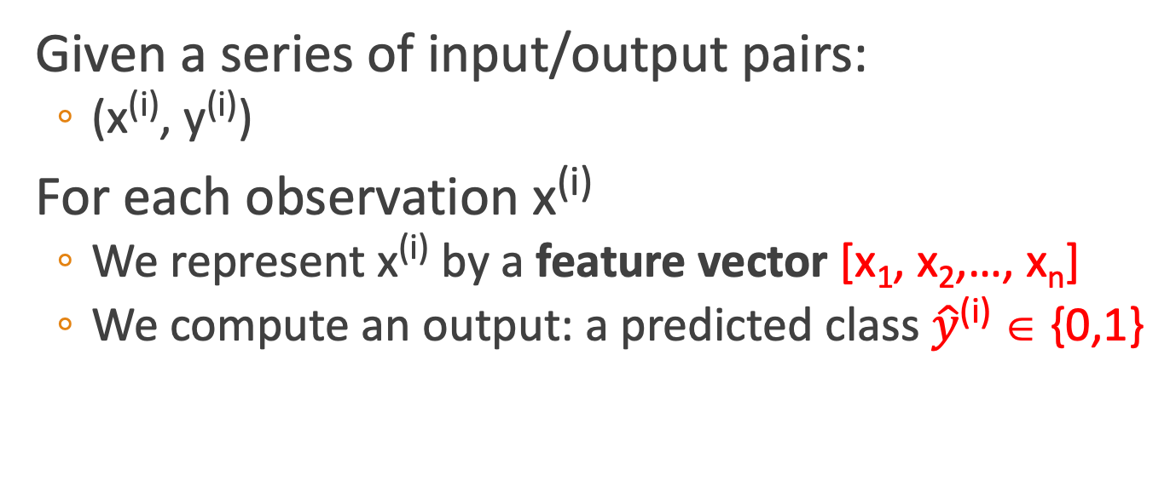
Binary Classification in Logistic Regression
Given a series of input/output pairs:
(x^{(i)}, y^{(i)})
For each observation x^{(i)}
We represent x^{(i)} by a feature vector [x₁, x₂,…, x_{n}]
We compute an output: a predicted class $\hat{y}$^{(i)} ∈ {0,1}

Slide 17
Features in logistic regression
For feature x_{i}, weight w_{i} tells is how important is x_{i}
x_{i} ="review contains ‘awesome’": w_{i} = +10
x_{j} ="review contains ‘abysmal’": w_{j} = -10
x_{k} =“review contains ‘mediocre’": w_{k} = -2
Notes:
The weight wi represents how important that input feature is to the classification decision, and can be positive (providing evidence that the in- stance being classified belongs in the positive class) or negative (providing evidence that the instance being classified belongs in the negative class). Thus we might expect in a sentiment task the word awesome to have a high positive weight, and abysmal to have a very negative weight.

Slide 18
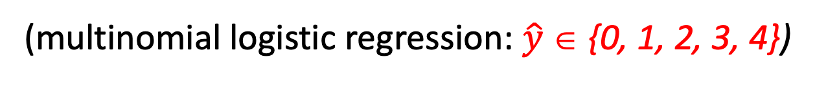
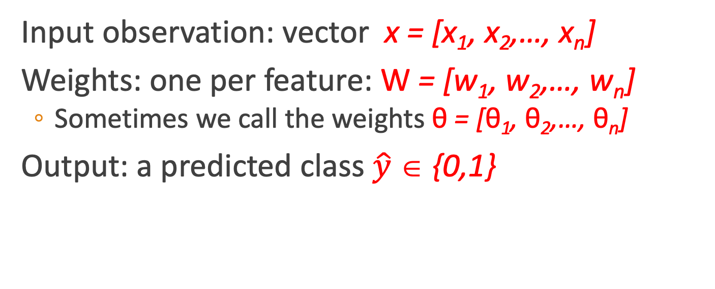
Logistic Regression for one observation x
Input observation: vector x = [x₁, x₂,…, x_{n}]
Weights: one per feature: W = [w₁, w₂,…, w_{n}]
Sometimes we call the weights θ = [θ₁, θ₂,…, θ_{n}]
Output: a predicted class $\hat{y}$ ∈ {0,1}
(multinomial logistic regression: $\hat{y}$ ∈ {0, 1, 2, 3, 4})

Slide 19

How to do classification
For each feature x_{i}, weight w_{i} tells us importance of x_{i}
(Plus we'll have a bias b)
We'll sum up all the weighted features and the bias
If this sum is high, we say y=1; if low, then y=0
$$z=\sum_{i=1}^{n}{w_{i}x_{i}+b}$$
Notes:
The bias term, also called the intercept, is another real number that’s added to the weighted inputs. In the rest of the book we’ll represent such sums using the dot product notation from linear algebra. The dot product of two vectors a and b, written as a · b is the sum of the products of the corresponding elements of each vector.

Slide 20
But we want a probabilistic classifier
We need to formalize “sum is high”
We’d like a principled classifier that gives us a probability, just like Naive Bayes did
We want a model that can tell us:
p(y=1|x; θ)
p(y=0|x; θ)

Slide 21
The problem: z isn't a probability, it's just a number!
Solution: use a function of z that goes from 0 to 1
Notes:
nothing in Eq. 5.3 forces z to be a legal probability, that is, to lie between 0 and 1. In fact, since weights are real-valued, the output might even be negative; z ranges from −∞ to ∞.

Slide 22
The very useful sigmoid or logistic function
Notes:
The sigmoid function The 1/1+e^-z (so-named because it looks like an s) is also called the logistic function. It takes a real value and maps it to the range [0, 1
It is nearly linear around 0 but outlier values get squashed toward 0 or 1.

Slide 23
Idea of logistic regression
We’ll compute w∙x+b
And then we’ll pass it through the sigmoid function:
σ(w∙x+b)
And we'll just treat it as a probability

Slide 24
Making probabilities with sigmoids
Notes:
We’re almost there. If we apply the sigmoid to the sum of the weighted features, we get a number between 0 and 1. To make it a probability, we just need to make sure that the two cases, p(y = 1) and p(y = 0), sum to 1. We can do this as follows:

Slide 25
By the way:
=
Because
Notes:
The sigmoid function has the property

Slide 26
Turning a probability into a classifier
0.5 here is called the decision boundary

Slide 27
The probabilistic classifier
P(y=1)
wx + b

Slide 28
Turning a probability into a classifier
if w∙x+b > 0
if w∙x+b ≤ 0

Slide 29
Logistic Regression
Logistic Regression: a text example on sentiment classification
Notes:
Let's walk through an example using logistic regression to do sentiment classification

Slide 30


Sentiment example: does y=1 or y=0?
It's hokey . There are virtually no surprises , and the writing is second-rate . So why was it so enjoyable ?
For one thing , the cast is great . Another nice touch is the music . I was overcome with the urge to get off the couch and start dancing . It sucked me in , and it'll do the same to you .
Notes:
Suppose we are doing binary sentiment classification on movie review text, and we would like to know whether to assign the sentiment class 1=positive or 0=negative to the following review

Slide 31
Notes:
We’ll represent each input observation by the 6 features x1...x6 of the input

Slide 32
Classifying sentiment for input x
Suppose w =
b = 0.1
Notes:
Let’s assume for the moment that we’ve already learned a real-valued weight for each of these features, and that the 6 weights corresponding to the 6 features are as follows. The weight w1, for example indicates how important a feature the number of positive lexicon words (great, nice, enjoyable, etc.) is to a positive sentiment decision, while w2 tells us the importance of negative lexicon words. Note that w1 = 2.5 is positive, while w2 = −5.0, meaning that negative words are negatively associated with a positive sentiment decision, and are about twice as important as positive words.

Slide 33
Classifying sentiment for input x
Notes:
Given these 6 features and the input review x, we can compute P(+|x) and P(−|x)

Slide 34
We can build features for logistic regression for any classification task: period disambiguation
End of sentence
This ends in a period.
The house at 465 Main St. is new.
Not end
Notes:
We might use features like x1 below expressing that the current word is lower case and the class is EOS (perhaps with a positive weight), or that the current word is in our abbreviations dictionary (“Prof.”) and the class is EOS (perhaps with a negative weight). A feature can also express a quite complex combination of properties. For example a period following an upper case word is likely to be an EOS, but if the word itself is St. and the previous word is capitalized, then the period is likely part of a shortening of the word street.

Slide 35
Classification in (binary) logistic regression: summary
Given:
a set of classes: (+ sentiment,- sentiment)
a vector x of features [x1, x2, …, xn]
x1= count( "awesome")
x2 = log(number of words in review)
A vector w of weights [w1, w2, …, wn]
w_{i} for each feature f_{i}

Slide 36
Logistic Regression
Learning: Cross-Entropy Loss
Notes:
Let's now turn to learning the parameters for logistic regression. We'll start with the cross-entropy loss function

Slide 37
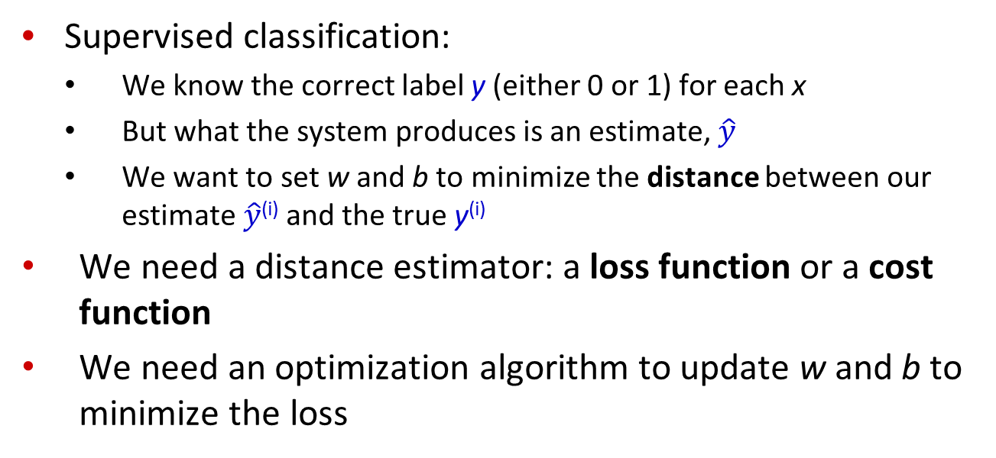
Wait, where did the W’s come from?
Supervised classification:
We know the correct label y (either 0 or 1) for each x
But what the system produces is an estimate, $\hat{y}$
We want to set w and b to minimize the distance between our estimate $\hat{y}$^{(i)} and the true y^{(i)}
We need a distance estimator: a loss function or a cost function
We need an optimization algorithm to update w and b to minimize the loss
Notes:
Logistic regression is an instance of supervised classification in which we know the correct label y (either 0 or 1) for each observation x. But what the system produces is an estimate, ^y. We want to learn parameters (meaning w and b) that make yˆ for each training observation as close as possible to the true y.

Slide 38
Learning components
A loss function:
cross-entropy loss
An optimization algorithm:
stochastic gradient descent
Notes:
This requires two components. The first is a metric for how close the current label (yˆ) is to the true gold label y. Rather than measure similarity, we usually talk about the opposite of this: the distance between the system output and the gold output, and we call this distance
the loss function or the cost function. We'll we’ll introduce the loss function that is commonly used for logistic regression and also for neural networks, the cross-entropy loss. The second thing we need is an optimization algorithm for iteratively updating
the weights so as to minimize this loss function. The standard algorithm for this is gradient descent; we’ll introduce the stochastic gradient descent algorithm in the following section.

Slide 39

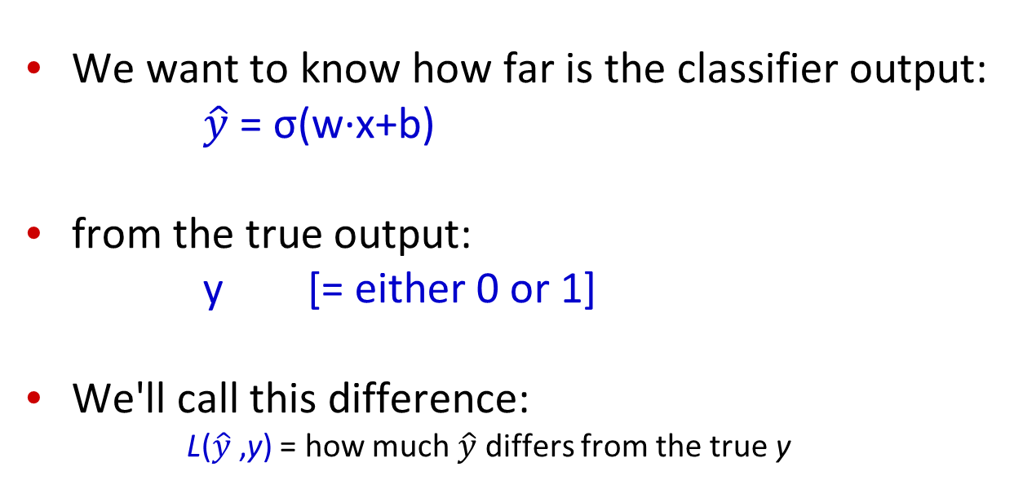
The distance between $\hat{y}$and y
We want to know how far is the classifier output:
$\hat{y}$= σ(w∙x+b)
from the true output:
y [= either 0 or 1]
We'll call this difference:
L($\hat{y}$,y) = how much $\hat{y}$ differs from the true y
Notes:
We need a loss function that expresses, for an observation x, how close the classifier output (yˆ = σ (w · x + b)) is to the correct output (y, which is 0 or 1).

Slide 40
Intuition of negative log likelihood loss = cross-entropy loss
A case of conditional maximum likelihood estimation
We choose the parameters w,b that maximize
the log probability
of the true y labels in the training data
given the observations x
Notes:
We do this via a loss function that prefers the correct class labels of the training examples to be more likely. This is called conditional maximum likelihood estimation: we choose the parameters w,b that maximize the log probability of the true y labels in the training data given the observations x. The resulting loss function is the negative log likelihood loss, generally called the cross-entropy loss.

Slide 41
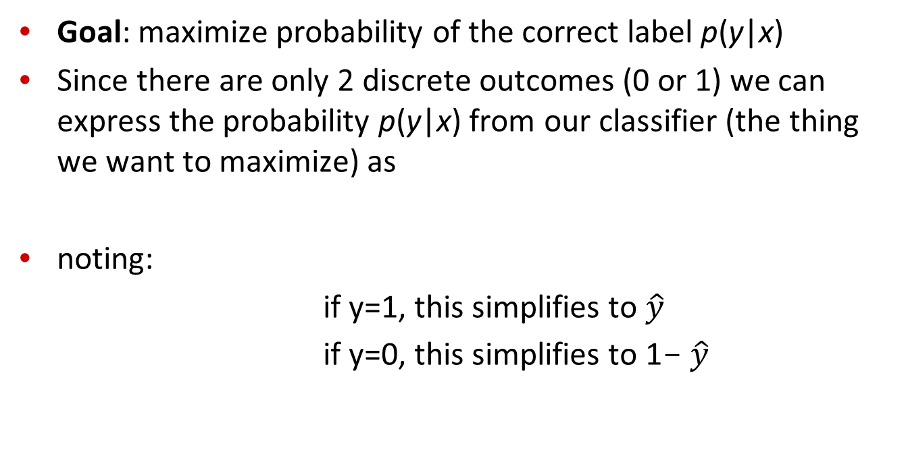
Deriving cross-entropy loss for a single observation x
Goal: maximize probability of the correct label p(y|x)
Since there are only 2 discrete outcomes (0 or 1) we can express the probability p(y|x) from our classifier (the thing we want to maximize) as
noting:
if y=1, this simplifies to $\hat{y}$
if y=0, this simplifies to 1- $\hat{y}$
Notes:
Let’s derive this loss function, applied to a single observation x. We’d like to learn weights that maximize the probability of the correct label, that's p(y|x).

Slide 42
Deriving cross-entropy loss for a single observation x
Goal: maximize probability of the correct label p(y|x)
Maximize:
Now take the log of both sides (mathematically handy)
Whatever values maximize log p(y|x) will also maximize p(y|x)
Maximize:

Slide 43
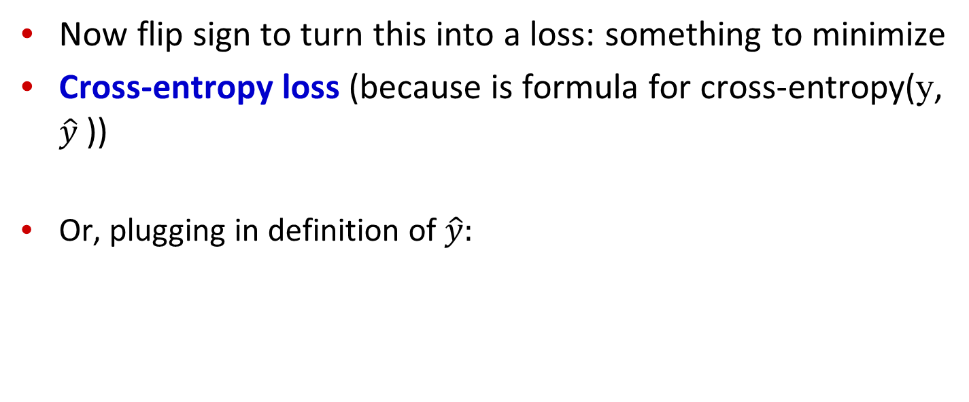
Deriving cross-entropy loss for a single observation x
Goal: maximize probability of the correct label p(y|x)
Maximize:
Now flip sign to turn this into a loss: something to minimize
Cross-entropy loss (because is formula for cross-entropy(y, $\hat{y}$))
Or, plugging in definition of $\hat{y}:$
Minimize:

Slide 44
Let's see if this works for our sentiment example
We want loss to be:
smaller if the model estimate is close to correct
bigger if model is confused
Let's first suppose the true label of this is y=1 (positive)
It's hokey . There are virtually no surprises , and the writing is second-rate . So why was it so enjoyable ? For one thing , the cast is great . Another nice touch is the music . I was overcome with the urge to get off the couch and start dancing . It sucked me in , and it'll do the same to you .

Slide 45
Let's see if this works for our sentiment example
True value is y=1. How well is our model doing?
Pretty well! What's the loss?

Slide 46
Let's see if this works for our sentiment example
Suppose true value instead was y=0.
What's the loss?
Notes:
By contrast, let’s pretend instead that the example was actually negative, i.e., the true y = 0 (perhaps the reviewer went on to say “But bottom line, the movie is terrible! I beg you not to see it!”) . In this case our model is confused, the model is wrong, so we’d want the loss to be higher. Let's plug in y = 0 and 1−σ(w·x+b) = .31

Slide 47
Let's see if this works for our sentiment example
The loss when model was right (if true y=1)
Is lower than the loss when model was wrong (if true y=0):
Sure enough, loss was bigger when model was wrong!

Slide 48
Logistic Regression
Stochastic Gradient Descent
Notes:
In this lecture we introduce the stochastic gradient descent algorithm used for optimizing the weights for logistic regression and neural networks.

Slide 49
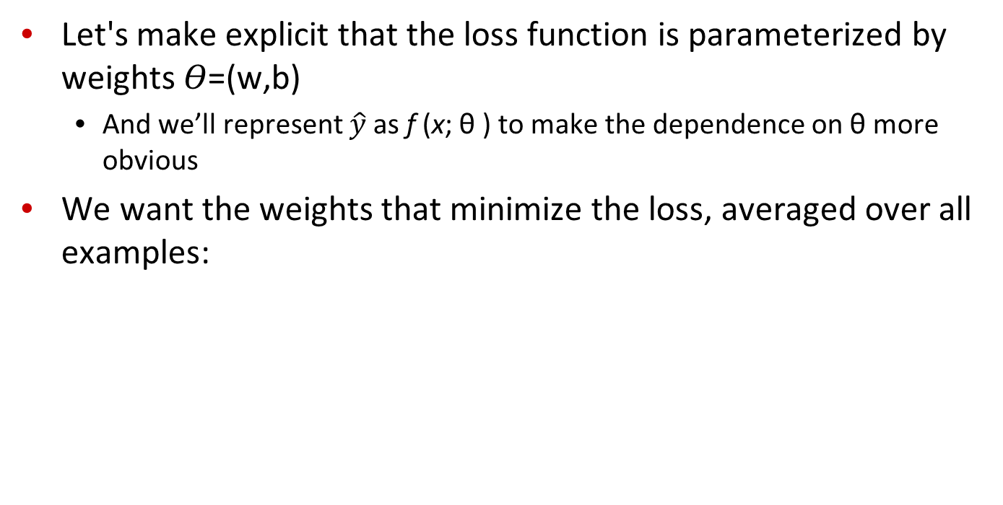
Our goal: minimize the loss
Let's make explicit that the loss function is parameterized by weights 𝛳=(w,b)
And we’ll represent $\hat{y}$as f (x; θ ) to make the dependence on θ more obvious
We want the weights that minimize the loss, averaged over all examples:
Notes:
Our goal with gradient descent is to find the optimal weights: minimize the loss function we’ve defined for the model. We’ll explicitly represent the fact that the loss function L is parameterized by the weights, which we can refer to in machine learning in general as θ (in the case of logistic regression θ = w, b). And we’ll represent $\hat{y}$as f (x; θ ) to make the dependence on θ more obvious. So the goal is to find the set of weights which minimizes the loss function, averaged over all examples: EQ

Slide 50

Intuition of gradient descent
How do I get to the bottom of this river canyon?
Look around me 360∘
Find the direction of steepest slope down
Go that way
x
Notes:
How do we find the minimum of a loss function? Gradient descent is a method that finds a minimum of a function by figuring out in which direction (in the space of the parameters θ) the function’s slope is rising the most steeply, and moving in the opposite direction.
The intuition is that if you are hiking in a canyon and trying to descend most quickly down to the river at the bottom, you might look around yourself 360 degrees, find the direction where the ground is sloping the steepest, and walk downhill in that direction.

Slide 51
Our goal: minimize the loss
For logistic regression, loss function is convex
A convex function has just one minimum
Gradient descent starting from any point is guaranteed to find the minimum
(Loss for neural networks is non-convex)
Notes:
For logistic regression, this loss function is conveniently convex. A convex function has just one minimum; there are no local minima to get stuck in, so gradient descent starting from any point is guaranteed to find the minimum. (By contrast, the loss for multi-layer neural networks is non-convex, and gradient descent may get stuck in local minima for neural network training and never find the global optimum.)

Slide 52
Let's first visualize for a single scalar w
Q: Given current w, should we make it bigger or smaller?
A: Move w in the reverse direction from the slope of the function
Notes:
Although the algorithm (and the concept of gradient) are designed for direction vectors, let’s first consider a visualization of the case where the parameter of our system is just a single scalar w. Given a random initialization of w at some value w1, and assuming the loss function L happened to have this shape, we need the algorithm to tell us whether at the next iteration we should move left (making w2 smaller than w1) or right (making w2 bigger than w1) to reach the minimum. The gradient descent algorithm answers this question by finding the gradient of the loss function at the current point and moving in the opposite direction.

Slide 53
Let's first visualize for a single scalar w
Q: Given current w, should we make it bigger or smaller?
A: Move w in the reverse direction from the slope of the function
So we'll move positive
Notes:
The gradient of a function of many variables is a vector pointing in the direction of the greatest increase in a function. The gradient is a multi-variable generalization of the slope, so for a function of one variable like the one in this figure, we can informally think of the gradient as the slope. The dotted line shows the slope of this hypothetical loss function at point w = w1 . You can see that the slope of this dotted line is negative.

Slide 54
Let's first visualize for a single scalar w
Q: Given current w, should we make it bigger or smaller?
A: Move w in the reverse direction from the slope of the function
So we'll move positive
Notes:
Thus to find the minimum, gradient descent tells us to go in the opposite direction: moving w in a positive direction.

Slide 55
Gradients
The gradient of a function of many variables is a vector pointing in the direction of the greatest increase in a function.
Gradient Descent: Find the gradient of the loss function at the current point and move in the opposite direction.

Slide 56
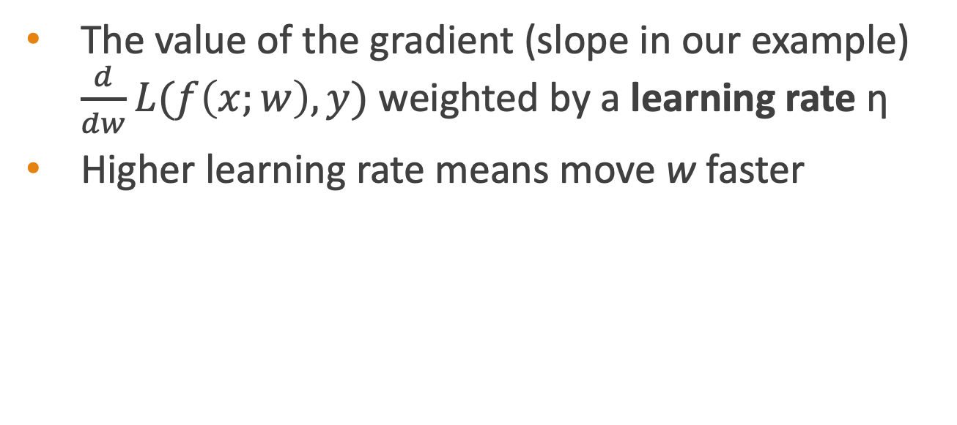
How much do we move in that direction ?
The value of the gradient (slope in our example) $\frac{d}{dw}L(f\left(x;w\right),y)$ weighted by a learning rate η
Higher learning rate means move w faster
Notes:
The magnitude of the amount to move in gradient descent is the value of the slope of the loss function (with respect to w) weighted by a learning rate η . A higher (faster) learning rate means that we should move w more on each step. The change we make in our parameter is the learning rate times the gradient (or the slope, in our single-variable example)

Slide 57
Now let's consider N dimensions
We want to know where in the N-dimensional space (of the N parameters that make up θ ) we should move.
The gradient is just such a vector; it expresses the directional components of the sharpest slope along each of the N dimensions.
Notes:
Now let’s extend the intuition from a function of one scalar variable w to many variables, because we don’t just want to move left or right, we want to know where in the N-dimensional space (of the N parameters that make up θ ) we should move. The gradient is just such a vector; it expresses the directional components of the sharpest slope along each of those N dimensions.

Slide 58
Imagine 2 dimensions, w and b
Visualizing the gradient vector at the red point
It has two dimensions shown in the x-y plane
Notes:
If we’re just imagining two weight dimensions (say for one weight w and one bias b), the gradient might be a vector with two orthogonal components, each of which tells us how much the ground slopes in the w dimension and in the b dimension. This figure shows a visualization of the value of a 2-dimensional gradient vector taken at the red point.

Slide 59
Real gradients
Are much longer; lots and lots of weights
For each dimension w_{i} the gradient component i tells us the slope with respect to that variable.
“How much would a small change in w_{i} influence the total loss function L?”
We express the slope as a partial derivative ∂ of the loss ∂w_{i}
The gradient is then defined as a vector of these partials.
Notes:
In an actual logistic regression, the parameter vector w is much longer than 1 or 2, since the input feature vector x can be quite long, and we need a weight wi for each xi. For each dimension/variable wi in w (plus the bias b), the gradient will have a component that tells us the slope with respect to that variable. Essentially we’re asking: “How much would a small change in that variable wi influence the total loss function L?” In each dimension wi, we express the slope as a partial derivative of the loss function with respect to wi. The gradient is then defined as a vector of these partials.

Slide 60

The gradient
We’ll represent $\hat{y}$as f (x; θ ) to make the dependence on θ more obvious:
The final equation for updating θ based on the gradient is thus
Notes:
Here's a vector of gradients. We’ll represent yˆ as f (x; θ ) to make the dependence on θ more obvious:

Slide 61
What are these partial derivatives for logistic regression?
The loss function
The elegant derivative of this function (see textbook 5.8 for derivation)
Notes:
In order to update θ , we need a definition for the gradient ∇L( f (x; θ ), y). Recall that for logistic regression, the cross-entropy loss function is: EQ
It turns out that the derivative of this function for one observation vector x is EQ
Note that the gradient with respect to a single weight w j represents a very intuitive value: the difference between the true y and our estimated yˆ = σ (w · x + b) for that observation, multiplied by the corresponding input value x j .

Slide 62
Notes:
Stochastic gradient descent is an online algorithm that minimizes the loss function by computing its gradient after each training example, and nudging θ in the right direction (the opposite direction of the gradient). The algorithm can terminate when it converges (or when the gradient norm < ε), or when progress halts (for example when the loss starts going up on a held-out set).

Slide 63
Hyperparameters
The learning rate η is a hyperparameter
too high: the learner will take big steps and overshoot
too low: the learner will take too long
Hyperparameters:
Briefly, a special kind of parameter for an ML model
Instead of being learned by algorithm from supervision (like regular parameters), they are chosen by algorithm designer.
Notes:
The learning rate η is a hyperparameter that must be adjusted. If it’s too high, the learner will take steps that are too large, overshooting the minimum of the loss function. If it’s too low, the learner will take steps that are too small, and take too long to get to the minimum. It is common to start with a higher learning rate and then slowly decrease it. Hyperparameters are a special kind of parameter for any machine learning model. Unlike regular parameters of a model (weights like w and b), which are learned by the algorithm from the training set, hyperparameters are special parameters chosen by the algorithm designer that affect how the algorithm works.

Slide 64
Logistic Regression
Stochastic Gradient Descent: An example and more details
Notes:
In this lecture we'll walk through an example of stochastic descent and give a few more details.

Slide 65
Working through an example
One step of gradient descent
A mini-sentiment example, where the true y=1 (positive)
Two features:
x₁ = 3 (count of positive lexicon words)
x₂ = 2 (count of negative lexicon words)
Assume 3 parameters (2 weights and 1 bias) in Θ⁰ are zero:
w₁ = w₂ = b = 0
η = 0.1
Notes:
Let’s walk though a single step of the gradient descent algorithm. We’ll use a simplified version of our sentiment classification example as it sees a single observation x, whose correct value is y = 1 (this is a positive review), and with only two features: x1 = 3 (count of positive lexicon words), and x2 = 2 (count of negative lexicon words). Let’s assume the initial weights and bias in θ_0 are all set to 0, and the initial learning rate η is 0.1:

Slide 66
Example of gradient descent
w₁ = w₂ = b = 0;
x₁ = 3; x₂ = 2
Update step for update θ is:
where
Gradient vector has 3 dimensions:
Notes:
Here's our update equation for SGD. In order to do this update to theta, we'll need to know the gradient of the loss function. In our mini example there are three parameters, so the gradient vector has 3 dimensions, for w1, w2, and b. We can compute the first gradient as follows:

Slide 67
Example of gradient descent
w₁ = w₂ = b = 0;
x₁ = 3; x₂ = 2
Update step for update θ is:
where
Gradient vector has 3 dimensions:

Slide 68
Example of gradient descent
w₁ = w₂ = b = 0;
x₁ = 3; x₂ = 2
Update step for update θ is:
where
Gradient vector has 3 dimensions:

Slide 69
Example of gradient descent
w₁ = w₂ = b = 0;
x₁ = 3; x₂ = 2
Update step for update θ is:
where
Gradient vector has 3 dimensions:

Slide 70
Example of gradient descent
w₁ = w₂ = b = 0;
x₁ = 3; x₂ = 2
Update step for update θ is:
where
Gradient vector has 3 dimensions:

Slide 71
Example of gradient descent
Now that we have a gradient, we compute the new parameter vector θ¹ by moving θ⁰ in the opposite direction from the gradient:
η = 0.1;

Slide 72
Example of gradient descent
Now that we have a gradient, we compute the new parameter vector θ¹ by moving θ⁰ in the opposite direction from the gradient:
η = 0.1;

Slide 73
Example of gradient descent
Now that we have a gradient, we compute the new parameter vector θ¹ by moving θ⁰ in the opposite direction from the gradient:
η = 0.1;

Slide 74
Example of gradient descent
Now that we have a gradient, we compute the new parameter vector θ¹ by moving θ⁰ in the opposite direction from the gradient:
η = 0.1;
Note that enough negative examples would eventually make w₂ negative
Notes:
Note that this observation x happened to be a positive example. We would expect that after seeing more negative examples with high counts of negative words, that the weight w2, the weight for the "negative lexicon feature', would shift to have a negative value.

Slide 75
Mini-batch training
Stochastic gradient descent chooses a single random example at a time.
That can result in choppy movements
More common to compute gradient over batches of training instances.
Batch training: entire dataset
Mini-batch training: m examples (512, or 1024)
Notes:
Stochastic gradient descent is called stochastic because it chooses a single random example at a time, moving the weights so as to improve performance on that single example. That can result in very choppy movements, so it’s common to compute the gradient over batches of training instances rather than a single instance.
For example in batch training we compute the gradient over the entire dataset. By seeing so many examples, batch training offers a superb estimate of which direction to move the weights, at the cost of spending a lot of time processing every single example in the training set to compute this perfect direction.
A compromise is mini-batch training: we train on a group of m examples (perhaps 512, or 1024) that is less than the whole dataset.
Mini-batch training also has the advantage of computational efficiency. The mini-batches can easily be vectorized, choosing the size of the mini-batch based on the computational resources. This allows us to process all the exam- ples in one mini-batch in parallel and then accumulate the loss, something that’s not possible with individual or batch training.

Slide 76
Logistic Regression
Regularization

Slide 77
Overfitting
A model that perfectly match the training data has a problem.
It will also overfit to the data, modeling noise
A random word that perfectly predicts y (it happens to only occur in one class) will get a very high weight.
Failing to generalize to a test set without this word.
A good model should be able to generalize

Slide 78
Overfitting
Useful or harmless features
+
X1 = "this"
X2 = "movie
X3 = "hated"
This movie drew me in, and it'll do the same to you.
X4 = "drew me in"
-
4gram features that just "memorize" training set and might cause problems
I can't tell you how much I hated this movie. It sucked.
X5 = "the same to you"
X7 = "tell you how much"

Slide 79
Overfitting
4-gram model on tiny data will just memorize the data
100% accuracy on the training set
But it will be surprised by the novel 4-grams in the test data
Low accuracy on test set
Models that are too powerful can overfit the data
Fitting the details of the training data so exactly that the model doesn't generalize well to the test set
How to avoid overfitting?
Regularization in logistic regression
Dropout in neural networks

Slide 80
Regularization
A solution for overfitting
Add a regularization term R(θ) to the loss function (for now written as maximizing logprob rather than minimizing loss)
Idea: choose an R(θ) that penalizes large weights
fitting the data well with lots of big weights not as good as fitting the data a little less well, with small weights

Slide 81
L2 Regularization (= ridge regression)
The sum of the squares of the weights
The name is because this is the (square of the) L2 norm ||θ||₂, = Euclidean distance of θ to the origin.
L2 regularized objective function:

Slide 82
L1 Regularization (= lasso regression)
The sum of the (absolute value of the) weights
Named after the L1 norm ||W||₁, = sum of the absolute values of the weights, = Manhattan distance
L1 regularized objective function:

Slide 83
Logistic Regression
Multinomial Logistic Regression

Slide 84
Multinomial Logistic Regression
Often we need more than 2 classes
Positive/negative/neutral
Parts of speech (noun, verb, adjective, adverb, preposition, etc.)
Classify emergency SMSs into different actionable classes
If >2 classes we use multinomial logistic regression
= Softmax regression
= Multinomial logit
= (defunct names : Maximum entropy modeling or MaxEnt
So "logistic regression" will just mean binary (2 output classes)

Slide 85
Multinomial Logistic Regression
The probability of everything must still sum to 1
P(positive|doc) + P(negative|doc) + P(neutral|doc) = 1
Need a generalization of the sigmoid called the softmax
Takes a vector z = [z1, z2, ..., zk] of k arbitrary values
Outputs a probability distribution
each value in the range [0,1]
all the values summing to 1

Slide 86
The softmax function
Turns a vector z = [z₁, z₂, ... , z_{k}] of k arbitrary values into probabilities

Slide 87
The softmax function
Turns a vector z = [z₁,z₂,...,z_{k}] of k arbitrary values into probabilities

Slide 88
Softmax in multinomial logistic regression
Input is still the dot product between weight vector w and input vector x
But now we’ll need separate weight vectors for each of the K classes.

Slide 89
Features in binary versus multinomial logistic regression
Binary: positive weight → y=1 neg weight → y=0
Multinominal: separate weights for each class:
w₅ = 3.0

Slide 90
Thanks for Your Attention!

